Slide 1
Introduction to Programming with Python

Slide 2
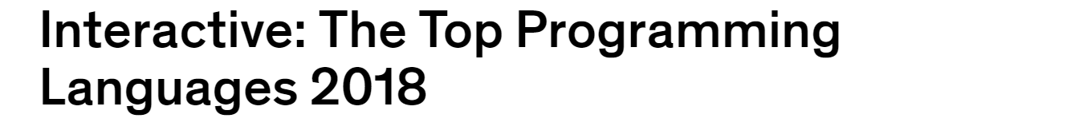

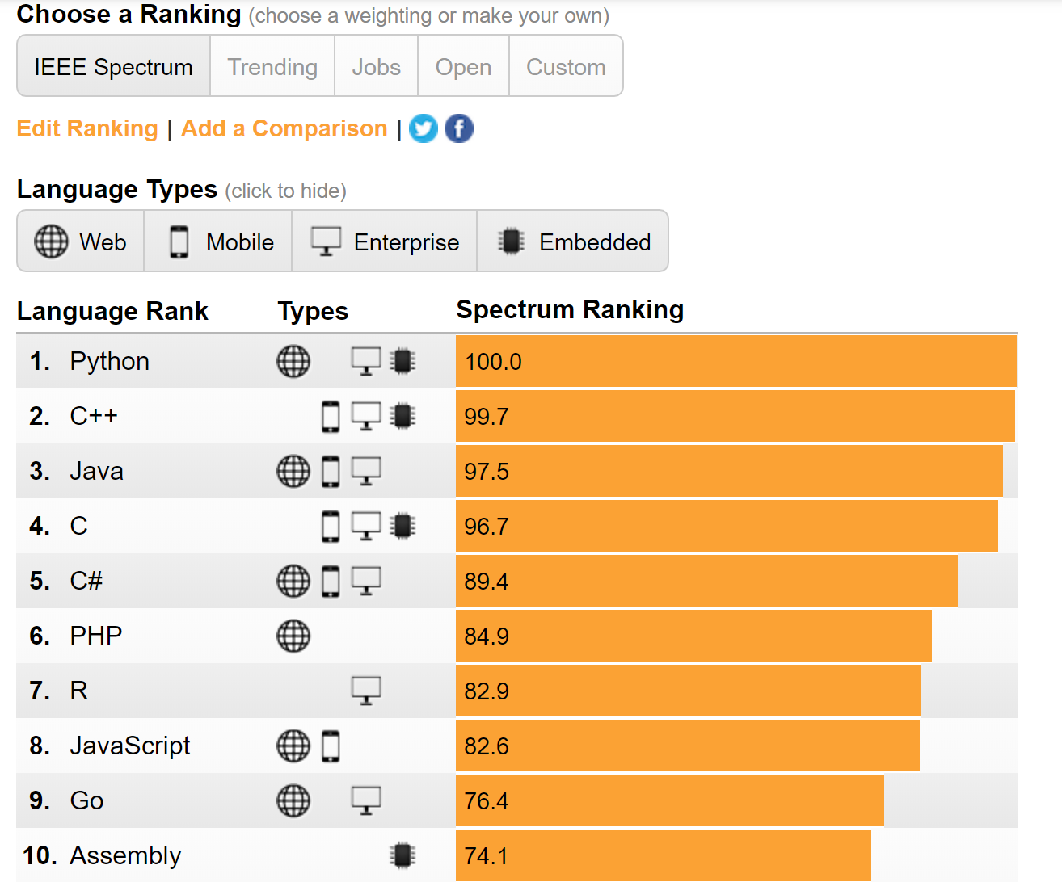
Why Python?
Python is a powerful,
multi-paradigm,
interpreted language popular
with start-ups.

Slide 3
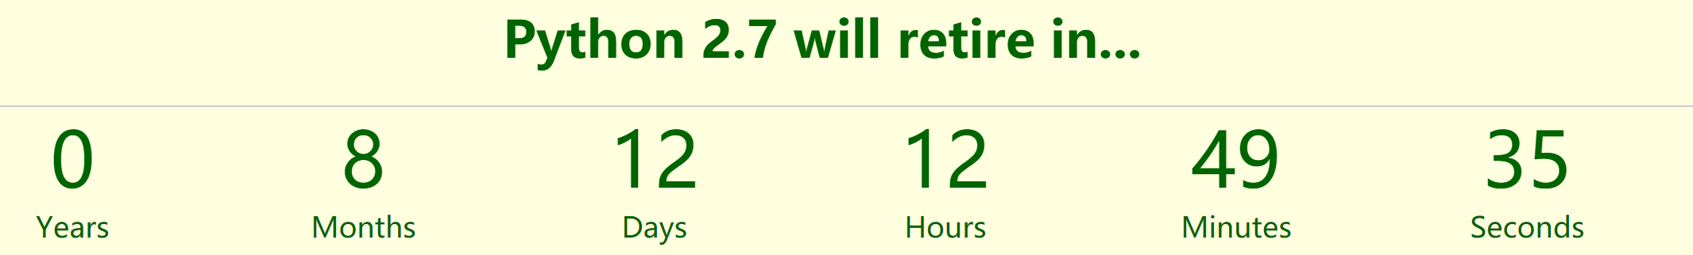
Python 2.7 or 3.x?
Python 2.7 will not be maintained past 2020. So Python 3.x (3.6 or 3.7)
is recommended for beginners.
(https://pythonclock.org/)

Slide 4
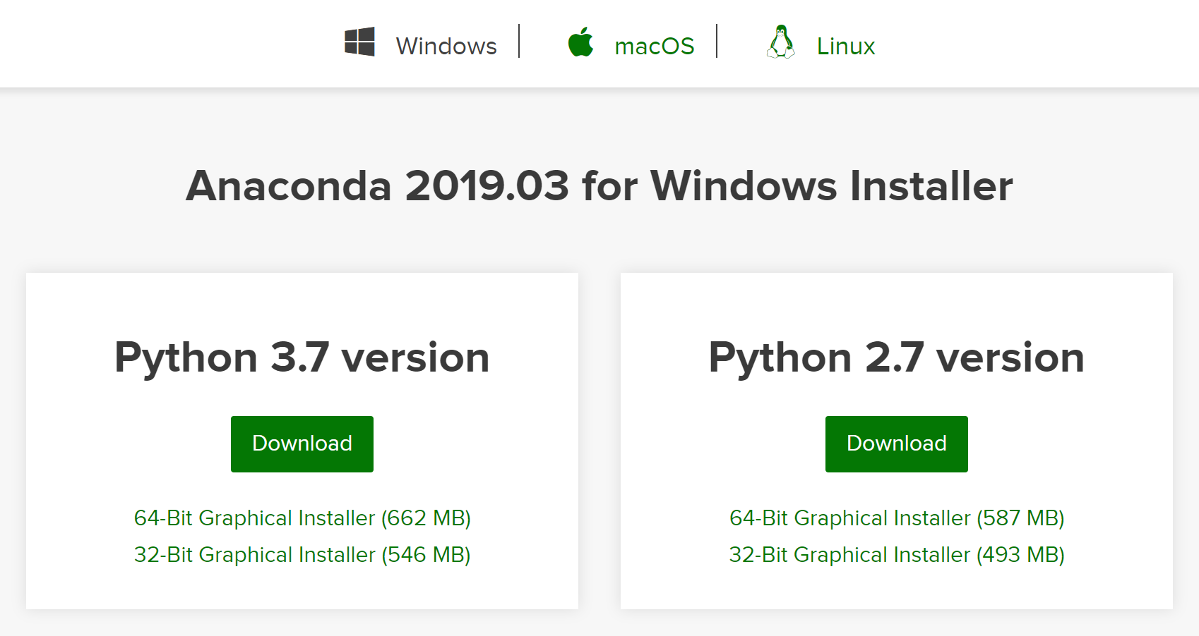
How to install?
Anaconda can give all the basic packages and coding environment you need.
(https://www.anaconda.com/distribution/#download-section)

Slide 5

How to install?
You can start your Python journey with Spyder or Jupyter notebook.

Slide 6
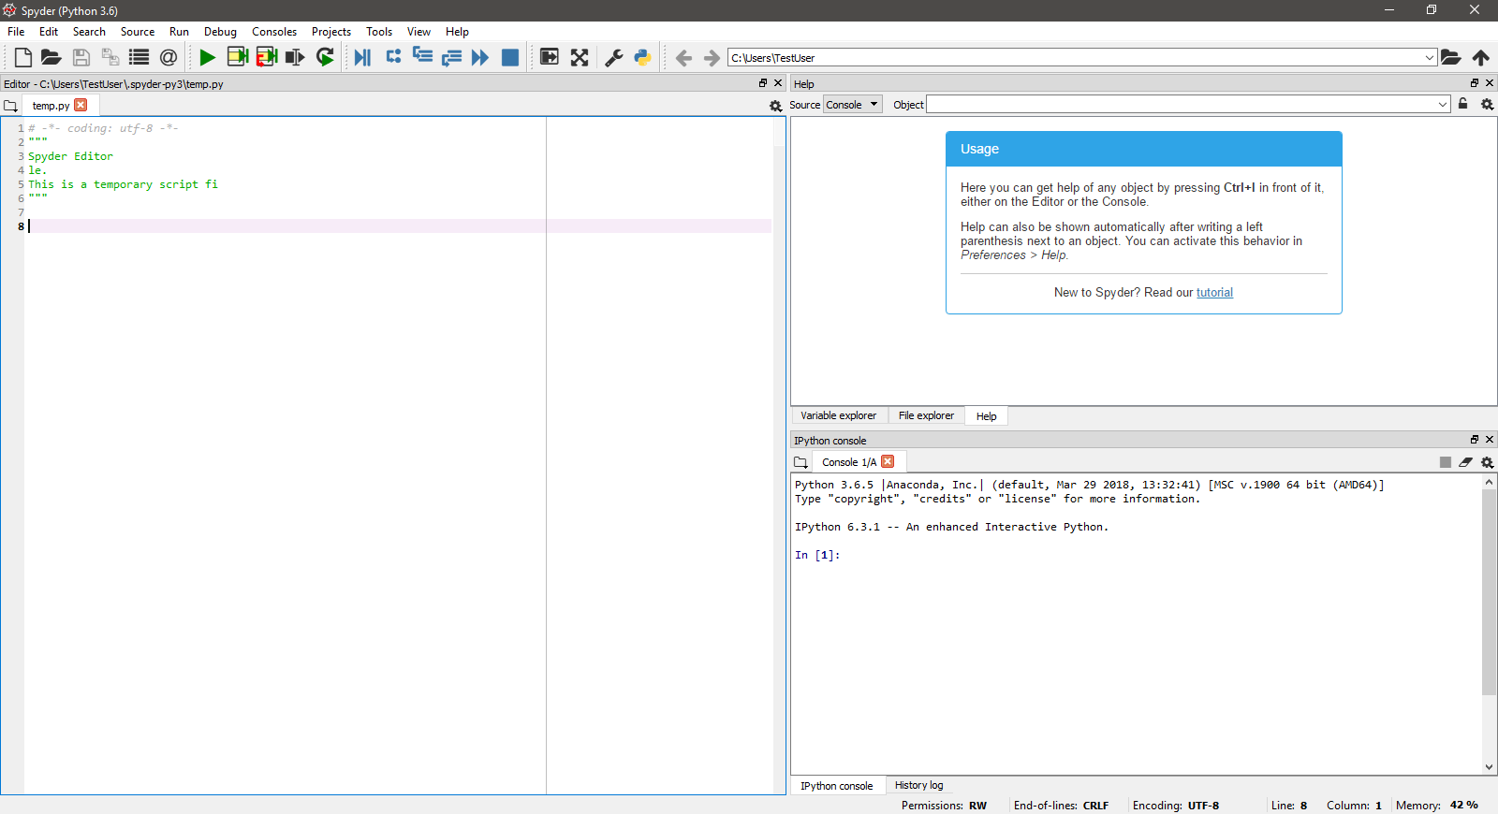
Development environment
Spyder is a light weight IDE (interactive development environment), compared to other
popular IDEs like PyCharm. Spyder can be launched directly in Anaconda navigator.
Variable explorer
Code editor
Interactive coding
environment

Slide 7
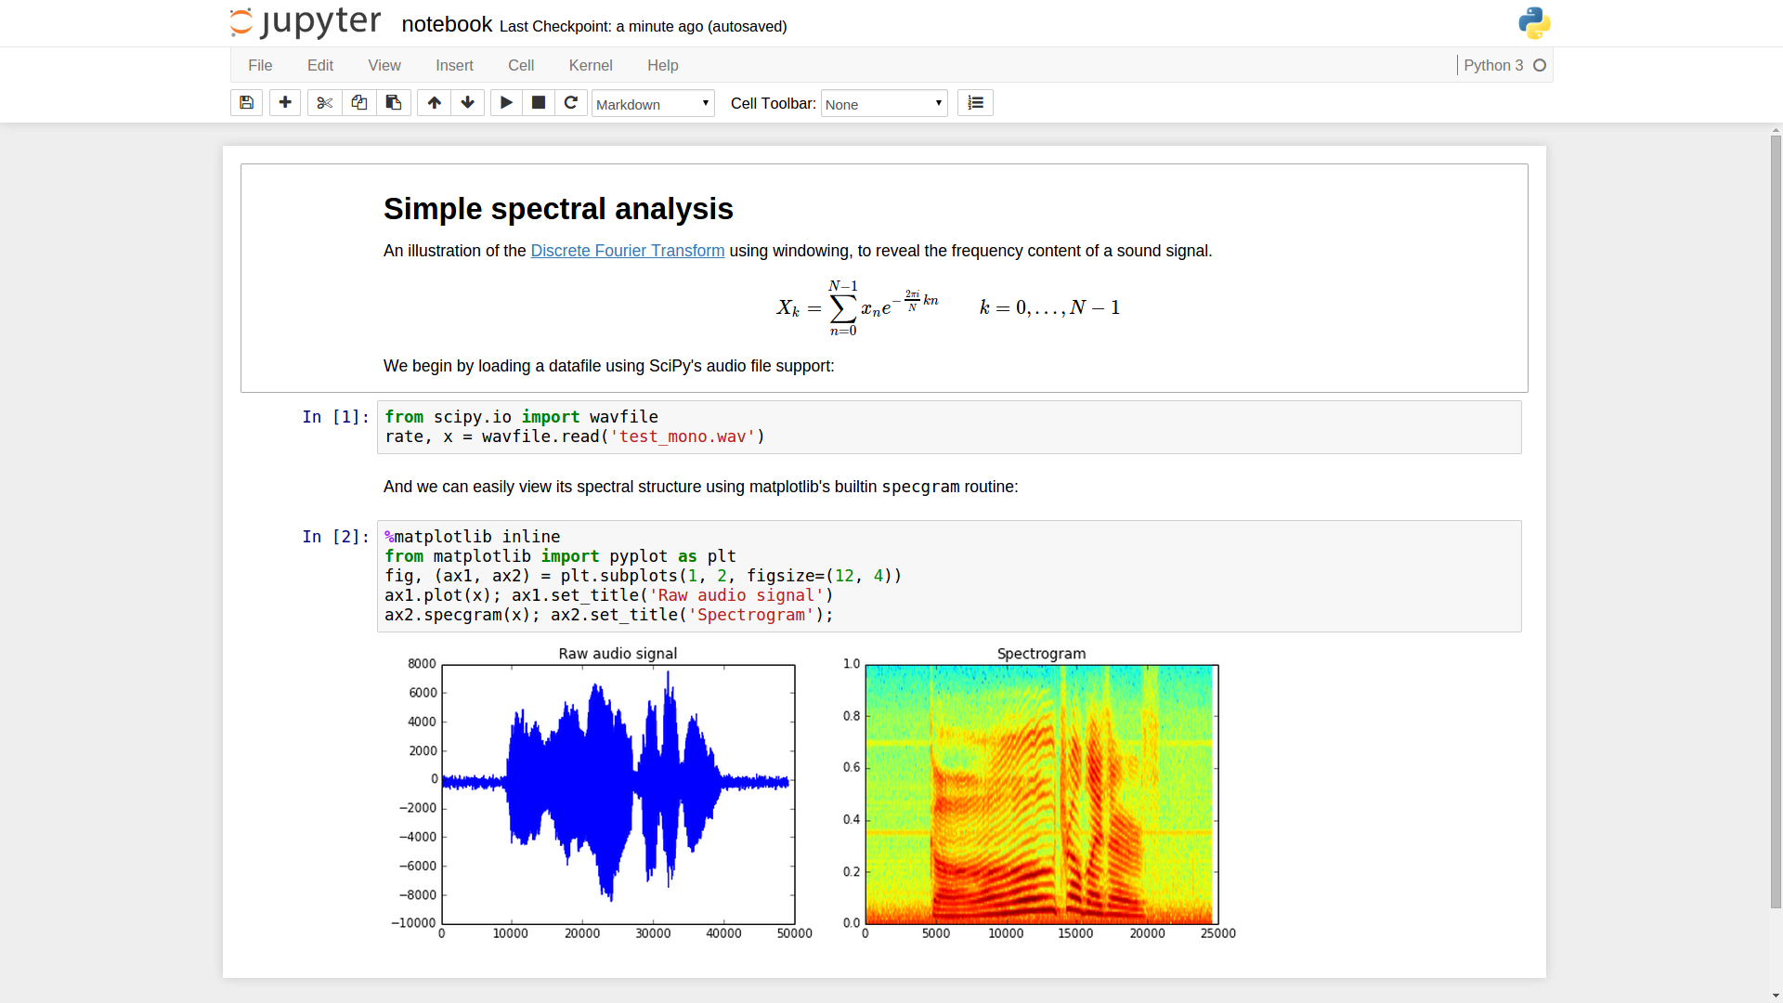
Development environment
Jupyter notebook will be used in this class since it can integrate the code and note into
one document very conveniently. Jupyter can be launched directly in Anaconda navigator.

Slide 8
A code sample
x = 34 – 23 # A comment
y = “Hello” z = 3.45
if z == 3.45 or y == “Hello”:
x = x + 1
y = y + “ World” # String concat
print(x)
print(y)

Slide 9
Enough to understand the code
Indentation matters to the meaning of the code:
Block structure indicated by indentation
The first assignment to a variable creates it.
Variable types don’t need to be declared.
Python figures out the variable types on its own.
Assignment uses = and comparison uses ==.
For numbers + - * / % are as expected.
Special use of + for string concatenation.
Special use of % for string formatting (as with printf in C)
Logical operators are words (and, or, not) not symbols
Simple printing can be done with print()
Notes:
语句块是在条件为真（条件语句）时执行或者执行多次（循环语句）的一组语句。在代码前放置空格来缩进语句即可创建语句块。

Slide 10
Basic Datatypes
Integers
z = 5//2 # Answer is 2, “//” means integer division
Floats
z = 5/2 # Answer is 2.5, “/” means float division
Strings
Can use “” or ‘’ to specify.
“abc” ‘abc’ (same thing)
Unmatched can occur within the string
“matt’s”
Use triple double-quotes for multi-line strings or strings
then contain both ‘ and “ inside of them
”””a’b”c”””

Slide 11
Whitespace
Whitespace is meaningful in Python: especially indentation
and placement of new lines.
Use a newline to end a line of code
Use \ when must go to the next line prematurely.
No braces { } (used in C, C++) to mark blocks of code in Python
Use consistent indentation instead
The first line with less indentation is outside of the block
The first line with more indentation starts a nested block
Often a colon appears at the start of a new block
(e.g. for function and class definitions)

Slide 12

Section 1: Basic programming
1. Sequence types:
Tuples, Lists, and Strings
Notes:
最基本的数据结构是序列（sequence），序列中的每个元素被分配一个序号——即元素的位置，索引。

Slide 13
Sequence Types
1. Tuple
A simple immutable ordered sequences of items
Immutable: a tuple cannot be modified once created
Items can be of mixed types, including collection types
2. Strings
Immutable
Conceptually very much like a tuple
3. List
Mutable ordered sequences of items of mixed types

Slide 14
Sequence Types
The three sequence types (tuples, strings, and lists) share much
of the same syntax and functionality
Tuples are defined using parentheses (and commas)
>>> tu = (23, 'abc', 4.56, (2,3), 'def')
Lists are defined using square brackets (and commas)
>>> li = ["abc", 34, 4.34, 23]
Strings are defined using quotes (“, ‘, or ”””)
>>> st1 = "Hello World"
>>> st2 = 'Hello World'
>>> st3 = """This is a multi-line
string that uses triple quotes."""

Slide 15
Sequence operations — indexing
We can access individual members of a tuple, list or string
using square bracket “array” notation
>>> tu = (23, 'abc', 4.56, (2,3), 'def')
>>> tu[1] # Second item in the tuple
‘abc’
Indexing starts from 0!
Important!!
>>> li = ["abc", 34, 4.34, 23]
>>> li[1] # Second item in the tuple
34
>>> st = “Hello World”
>>> st[1] # Second character in string
‘e’
Notes:
Python 用中括号表示索引，索引从0开始，表示第一个元素

Slide 16
Negative indices
>>> tu = (23, 'abc', 4.56, (2,3), 'def')
Positive index: count from the left, starting with 0
>>> tu[1]
‘abc’
Negative lookup: count from right, starting with -1
>>> tu[-3]
4.56

Slide 17
Slicing: Return copy of a subset
>>> tu = (23, 'abc', 4.56, (2,3), 'def')
Return a copy of the container with a subset of the original members. Start copying at the first index, and stop copying before the second index.
>>> tu[1:4] (‘abc’, 4.56, (2,3))
You can also use negative indices when slicing.
>>> tu[1:-1] (‘abc’, 4.56, (2,3))
Optional argument allows selection of every nth item.
>>> tu[1:-1:2] (‘abc’, (2,3))

Slide 18
Slicing: Return copy of a subset
>>> tu = (23, 'abc', 4.56, (2,3), 'def')
Omit the first index to make a copy starting from the beginning of the container.
>>> tu[:2] (23, ‘abc’)
Omit the second index to make a copy starting at the first index and going to the end of the container.
>>> tu[2:] (4.56, (2,3), ‘def’)

Slide 19
Copying the whole sequence
To make a copy of an entire sequence, you can use [:].
>>> tu = (23, 'abc', 4.56, (2,3), 'def')
>>> tu[:]
(23, 'abc', 4.56, (2,3), 'def')
Note the difference between these two lines for mutable
sequences:
>>> list2 = list1 # 2 names refer to 1 ref
# Change one affect both
>>> list2 = list1[:] # 2 independent copies, two refs

Slide 20
The‘in’operator
Boolean test whether a value is inside a collection (often
called a container in Python:
>>> t = [1, 2, 4, 5] >>> 3 in t False >>> 4 in t True >>> 4 not in t False
For strings, tests for substrings
>>> a = 'abcde' >>> 'c' in a True >>> ‘ac' in a False
Notes:
检查成员资格

Slide 21
The‘+’and ‘*’operator
The + operator produces a new tuple, list, or string whose value is the concatenation of its arguments.
Extends concatenation from strings to other types
>>> (1, 2, 3) + (4, 5, 6) (1, 2, 3, 4, 5, 6)
>>> (1, 2, 3)*2 (1, 2, 3, 1,2,3)
>>> [1, 2, 3] + [4, 5, 6] [1, 2, 3, 4, 5, 6]
>>> [1, 2, 3] *2
[1, 2, 3, 1,2,3]
>>> “Hello” + “ ” + “World” ‘Hello World’
>>> “Hello” *2
‘HelloHello’
Notes:
序列相加

Slide 22
The length, maximum and minimum
>>> numbers = [100, 34, 678]
>>> len(numbers)
3
>>> max(numbers)
678
>>> min(numbers)
34
>>> max(2, 3)
3
>>> min(9, 3, 2, 5)
2
Notes:
Built-in functions

Slide 23
Mutability: Tuples VS Lists
Lists: Mutable
>>> li = [‘abc’, 23, 4.34, 23]
>>> li[1] = 45
>>> li
[‘abc’, 23, 4.34, 23]
We can change lists in place
Name li still points to the same memory reference when we’re down

Slide 24
Mutability: Tuples VS Lists
Tuples: Immutable
>>> t = (23, ‘abc’, 4.56, (2,3), ‘def’) >>> t[2] = 3.14
Traceback (most recent call last): File "<pyshell#75>", line 1, in -topleveltu[2] = 3.14 TypeError: object doesn't support item assignment
You can’t change a tuple
The immutability of tuples means they’re faster than lists

Slide 25
Operations on Lists only
>>> li = [1, 11, 3, 4, 5]
>>> li.append(‘a’) # Note the method syntax >>> li
[1, 11, 3, 4, 5, ‘a’]
>>> li.insert(2, ‘i’) >>>li
[1, 11, ‘i’, 3, 4, 5, ‘a’ ]

Slide 26
The extend method vs the + operator
+ creates a fresh list (with a new memory reference)
extend operates on list in place
>>> li.extend([9, 8, 7]) >>>li
[1, 2, ‘i’, 3, 4, 5, ‘a’, 9, 8, 7]
>>> li.append([10, 11, 12]) >>> li
[1, 2, ‘i’, 3, 4, 5, ‘a’, 9, 8, 7, [10, 11, 12]]

Slide 27
Operations on Lists only
>>> li = [‘a’, ‘b’, ‘c’, ‘b’]
>>> li.index(‘b’) # index of first occurrence
1
>>> li.count(‘b’) # number of occurrences
2
>>> li.remove(‘b’) # remove first occurrence
>>> li
[‘a’, ‘c’, ‘b’]

Slide 28
Operations on Lists only
>>> li = [5, 2, 6, 8]
>>> li.reverse() # reverse the list *in place* >>> li
[8, 6, 2, 5]
>>> x = [4, 6, 2, 1, 7, 9]
>>> y = sorted(x)
[1, 2, 4, 6, 7, 9]
>>> y1 = sorted(x,reverse=True)
[9, 7, 6, 4, 2, 1]

Slide 29
Tuples vs Lists
Lists slower but more powerful than tuples
Lists can be modified, and they have lots of handy operations we can perform on them.
Tuples are immutable and have fewer features
To convert between tuples and lists use the list() and tuple() functions: li = list(tu) tu = tuple(li)

Slide 30

Dictionaries: a mapping collection type
Notes:
列表适合于将值组织到一个结构中，并且通过编号对其进行引用。字典是通过名字来引用值的数据结构，这种类型的数据结构称为映射。字典就是若干个键值对组成的数据。

Slide 31
Dictionaries
Dictionaries store a mapping between a set of keys and a set of values
Keys can be any immutable type
Values can be any type
Values and keys can be of different types in a single dictionary
You can
define
modify
view
lookup
delete
the key-value pairs in the dictionary.

Slide 32
Creating and accessing dictionaries
>>> d = {‘user’:‘bozo’, ‘pswd’:1234}
>>> d[‘user’] ‘bozo’
>>> d[‘pswd’] 1234
>>> d[‘bozo’]
Traceback (innermost last): File ‘<interactive input>’ line 1, in ? KeyError: bozo

Slide 33
Updating dictionaries
>>> d = {‘user’:‘bozo’, ‘pswd’:1234}
>>> d[‘user’] = ‘clown’ >>> d {‘user’:‘clown’, ‘pswd’:1234}
Keys must be unique.
Assigning to an existing key replaces its value.
>>> d[‘id’] = 45 >>> d {‘user’:‘clown’, ‘id’:45, ‘pswd’:1234}
Dictionaries are unordered New entry might appear anywhere in the output.

Slide 34
Removing dictionaries entries
>>> d = {‘user’:‘bozo’, ‘p’:1234, ‘i’:34}
>>> del d[‘user’] # Remove one. Note that del is a function.
>>> d {‘p’:1234, ‘i’:34}
>>> d.clear() # Remove all. >>> d {}
>>> a=[1,2] >>> del a[1] # (del also works on lists) >>> a [1]

Slide 35
Useful accessor methods
>>> d = {‘user’:‘bozo’, ‘p’:1234, ‘i’:34}
>>> d.keys() # List of current keys [‘user’, ‘p’, ‘i’]
>>> d.values() # List of current values. [‘bozo’, 1234, 34]
>>> d.items() # List of item tuples. [(‘user’,‘bozo’), (‘p’,1234), (‘i’,34)]

Slide 36

Boolean expressions

Slide 37
True and False
True and False are constants
Other values are treated as equivalent to either True or False when used in conditionals:
False: zero, None, empty containers
True: non-zero numbers, non-empty objects
Comparison operators: ==, !=, <, <=, etc.
X == Y
X and Y have same value
X is Y :
X and Y refer to the exact same object

Slide 38
Logical operators
You can also combine Boolean expressions.
True if a is True and b is True: a and b
True if a is True or b is True: a or b
True if a is False: not a
Operator | Example | Result
and | 9 != 6 and 2 < 3 | True
or | 2 == 3 or -1 < 5 | True
not | not 7 > 0 | False

Slide 39
Logical operators
Operator | Meaning | Example | Result
== | equals | 1 + 1 == 2 | True
!= | does not equal | 3.2 != 2.5 | True
< | less than | 10 < 5 | False
> | greater than | 10 > 5 | True
<= | less than or equal to | 126 <= 100 | False
>= | greater than or equal to | 5.0 >= 5.0 | True

Slide 40
Conditional expressions
x = true_value if condition else false_value
lazy evaluation:
First, condition is evaluated
If True, true_value is evaluated and returned
If False, false_value is evaluated and returned

Slide 41

String operations

Slide 42
String operations
The string class provides a number of methods for useful
formatting operations:
>>> “hello”.upper()
‘HELLO’
use <string>.strip() to strip off final newlines from lines read from files
>>> str1 = 'abc '
>>> print(len(str1))
>>> print(len(str1.strip()))

Slide 43
String Formatting Operator: %
The operator % allows strings to be built out of many data items in a “fill in the blanks” fashion.
Allows control of how the final string output will appear.
For example, we could force a number to display with a specific number of digits after the decimal point.
>>> x = “abc” >>> y = 34 >>> “%s xyz %d” % (x, y) ‘abc xyz 34’
The tuple following the % operator is used to fill in the blanks in the original string marked with %s or %d.

Slide 44
Printing with Python
print a string to the standard output stream using “print()”
Using the % string operator in combination with the print command, we can format our output text.
>>> print(“%s xyz %d” % (“abc”, 34)) abc xyz 34
“Print” automatically adds a newline to the end of the string. If you include a list of strings, it will concatenate them with a space between them.
>>> print(“abc”, “def”)
abc def

Slide 45
Printing with Python using .format()
You can use {} to mark where a variable will be substituted and can provide
detailed formatting directives, but you also need to provide the information
to be formatted.
>>> '{} {}'.format('one', 'two')
‘one two’
>>> '{:.2f}'.format(3.141592653589793)
‘3.14’
.2 means two decimal, f means float type.
You can refer to https://pyformat.info/ for more usage information.

Slide 46
String to List to String
Join turns a list of strings into one string.
<separator_string>.join(<some_list>)
>>> “;”.join([“abc”, “def”, “ghi”]) “abc;def;ghi”
Split turns one string into a list of strings.
<some_string>.split(<separator_string)
>>> “abc;def;ghi”.split(“;”) [“abc”, “def”, “ghi”]

Slide 47
Convert Anything to a String
The built-in str() function can convert an instance of any data
type into a string
You can define how this function behaves for user-created data types. You can also redefine the behavior of this function for many types.
>>> “Hello ” + str(2) “Hello 2”

Slide 48

2. Control flow：
conditional and loop statement

Slide 49
if Statements
if x == 3: print("X equals 3.“) elif x == 2: print("X equals 2.“) else: print("X equals something else.“) print("This is outside the ‘if’.“)
Note:
Use of indentation for blocks
Colon (:) after boolean expression

Slide 50
while Loops
>>> x = 3 >>> while x < 5: print(x, "still in the loop”) x = x + 1 3 still in the loop 4 still in the loop
>>> x = 6 >>> while x < 5: print(x, "still in the loop”)

Slide 51
break and continue
You can use the keyword break inside a loop to leave the while loop entirely.
You can use the keyword continue inside a loop to stop processing the current iteration of the loop and immediately go on to the next one.

Slide 52
assert
An assert statement will check to make sure that something is true during the course of a program
If the condition if false, the program stops
(more accurately: throws an exception)
assert(number_of_players < 5)

Slide 53
for loops
A for loop steps through each of the items in a collection type, or any other type of object which is “iterable”
for <item> in <collection>: <statements>
If <collection> is a list or a tuple, then the loop steps through each element of the sequence.
If <collection> is a string, then the loop steps through each character of the string.
for someChar in “Hello World”: print(someChar)
Notes:
While语句非常灵活，可以用来在任何为真的情况下重复执行一个代码块。一般情况下就够用了，但是有些时候还是得量体裁衣。
比如要为一个集合（序列和其他可迭代对象）的每个元素都执行一个代码块。List, tuple, str，dict都是可迭代对象。

Slide 54
for loops
for <item> in <collection>: <statements>
<item> can be more complex than a single variable name.
If the elements of <collection> are themselves collections, then <item> can match the structure of the elements.
for (x, y) in [(a,1), (b,2), (c,3), (d,4)]: print(x)

Slide 55
for loops and the range() function
We often want to write a loop where the variables ranges over some sequence of numbers. The range() function returns a list of numbers from 0 up to but not including the number we pass to it
range(5) returns [0,1,2,3,4]
for x in range(5): print(x)

Slide 56
Abuse of the range() function
Don't use range() to iterate over a sequence solely to have the index and elements available at the same time
Avoid:
for i in range(len(mylist)): print(i, mylist[i])
Instead:
for (i, item) in enumerate(mylist): print(i, item)

Slide 57

Generating lists using
“List comprehensions”
Notes:
列表表达式（推导式）是一种轻量级循环，是利用其他列表创建新列表（类似于数学术语中的集合推导式）的一种方法。其工作方式类似于for循环。

Slide 58
List comprehension
A powerful feature of the Python language
Generate a new list by applying a function to every member of an original list.
Python programmers use list comprehensions extensively. You’ll see many of them in real code.
[ expression for name in list ]

Slide 59
List comprehension
>>> li = [3, 6, 2, 7] >>> [elem*2 for elem in li] [6, 12, 4, 14]
[ expression for name in list ]
Where expression is some calculation or operation acting upon the variable name.
For each member of the list, the list comprehension 1. sets name equal to that member, and 2. calculates a new value using expression
It then collects these new values into a list which is the return value of the list comprehension.

Slide 60
List comprehension
If the elements of list are other collections, then name can be replaced by a collection of names that match the “shape” of the list members
>>> li = [(‘a’, 1), (‘b’, 2), (‘c’, 7)] >>> [ n * 3 for (x, n) in li] [3, 6, 21]

Slide 61
Filtered list comprehension
[ expression for name in list if filter]
Filter determines whether expression is performed on each member of the list.
When processing each element of list, first check if it satisfies the filter condition.
If the filter condition returns False, that element is omitted from the list before the list comprehension is evaluated.

Slide 62
Filtered list comprehension
[ expression for name in list if filter]
>>> li = [3, 6, 2, 7, 1, 9] >>> [elem * 2 for elem in li if elem > 4] [12, 14, 18]
Only 6, 7, and 9 satisfy the filter condition.
So, only 12, 14, and 18 are produced.

Slide 63
Nested list comprehension
Since list comprehensions take a list as input and produce a list as output, they are easily nested:
>>> li = [3, 2, 4, 1] >>> [elem*2 for elem in [item+1 for item in li] ] [8, 6, 10, 4]
The inner comprehension produces: [4, 3, 5, 2].
So, the outer one produces: [8, 6, 10, 4]

Slide 64

3. Functions and Classes in Python

Slide 65
Define functions
Function definition begins with def Function name and its arguments.
def get_final_answer(filename): """Documentation String""" line1 line2 return total_counter ……
colon
‘return’ indicates the value to be sent back to the caller.
First line with less indentation is considered to be outside of the function definition
No declaration of types of arguments or result

Slide 66
Calling a function
>>> def myfun(x, y): return x * y >>> myfun(3, 4) 12

Slide 67
Functions without returns
All functions in Python have a return value
even if no return line inside the code
Functions without a return return the special value None
None is a special constant in the language.
None is also logically equivalent to False.
The interpreter doesn’t print None

Slide 68
Functions are first-class objects in Python
Functions can be used just like any other data
They can be
Arguments to function
Return values of functions
Assigned to variables
Parts of tuples, lists, etc
>>> def myfun(x): return x*3
>>> def apply(q, x): return q(x)
>>> apply(myfun, 7) 21

Slide 69
Lambda notation
Functions can be defined without giving them names
This is most useful when passing a short function as an argument to another function.
>>> apply(lambda z: z * 4, 7) 28
The first argument to apply() is an unnamed function that takes one input and returns the input multiplied by four.
Note: only single-expression functions can be defined using this lambda notation.

Slide 70
Default values for arguments sample
You can provide default values for a function’s arguments
These arguments are optional when the function is called
>>> def myfun(b, c=3, d=“hello”): return b + c >>> myfun(5,3,”hello”) >>> myfun(5,3) >>> myfun(5)
All of the above function calls return 8.

Slide 71
Keyword arguments
Functions can be called with arguments out of order
These arguments are specified in the call
Keyword arguments can be used for a final subset of the arguments.
>>> def myfun (a, b, c): return a-b
>>> myfun(2, 1, 43) 1
>>> myfun(c=43, b=1, a=2) 1
>>> myfun(2, c=43, b=1) 1

Slide 72

Object Oriented Programming

Slide 73
Object Oriented Programming (OOP)
Python is a multi-paradigm programming language. Meaning, it supports different programming approach.
One of the popular approach to solve a programming problem is by creating objects. This is known as Object-Oriented Programming (OOP).
An object has two characteristics:
attributes
behavior
Let's take an example: Parrot is an object,
name, age, color are attributes
singing, dancing are behavior

Slide 74
Object Oriented Programming (OOP)
The concept of OOP in Python focuses on creating reusable code.
This concept is also known as DRY (Don't Repeat Yourself).
In Python, the concept of OOP follows some basic principles:
Principles | explanation
Inheritance | A process of using details from a new class without modifying existing class.
Encapsulation | Hiding the private details of a class from other objects.
Polymorphism | A concept of using common operation in different ways for different data input.

Slide 75
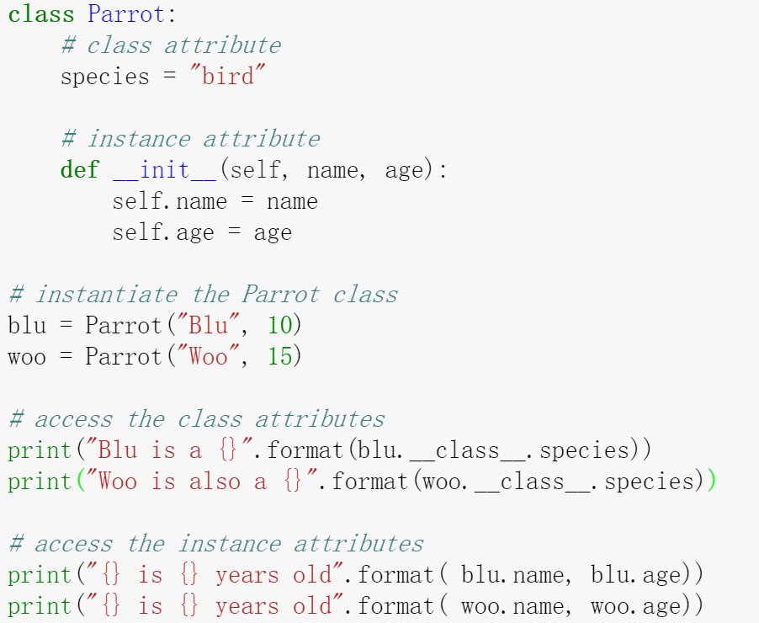
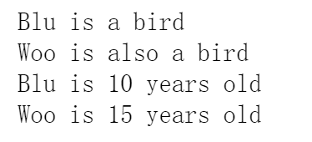
Create class and object
A class is a blueprint for the object. An object (instance) is an
instantiation of a class.

Slide 76
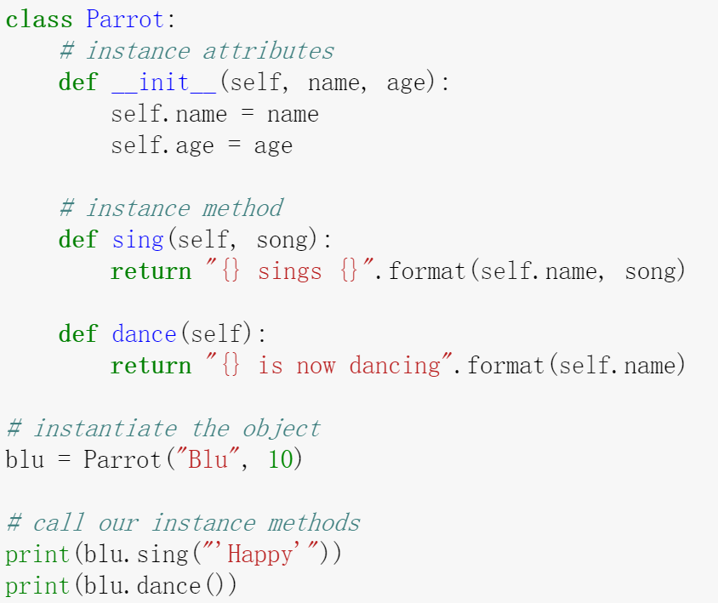
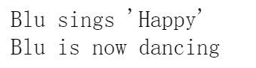
Create methods
Methods are functions defined inside the body of a class.
They are used to define the behaviors of an object.

Slide 77
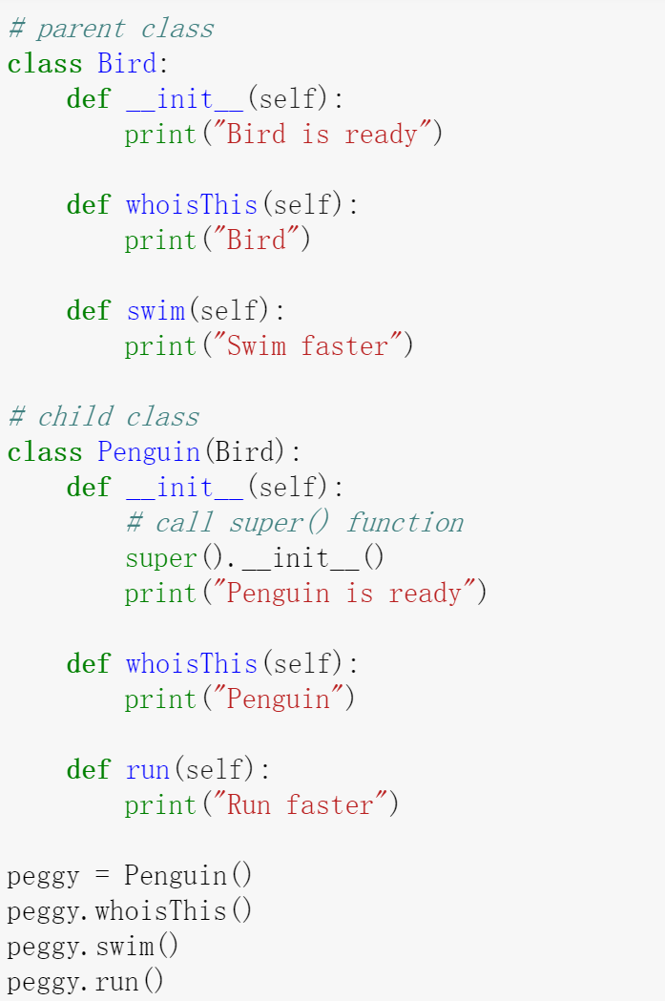
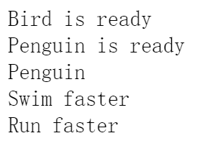
Inheritance
Inheritance is a way of creating new class for using
details of existing class without modifying it.
The newly formed class is a derived class (or child
class). Similarly, the existing class is a base class
(or parent class).

Slide 78
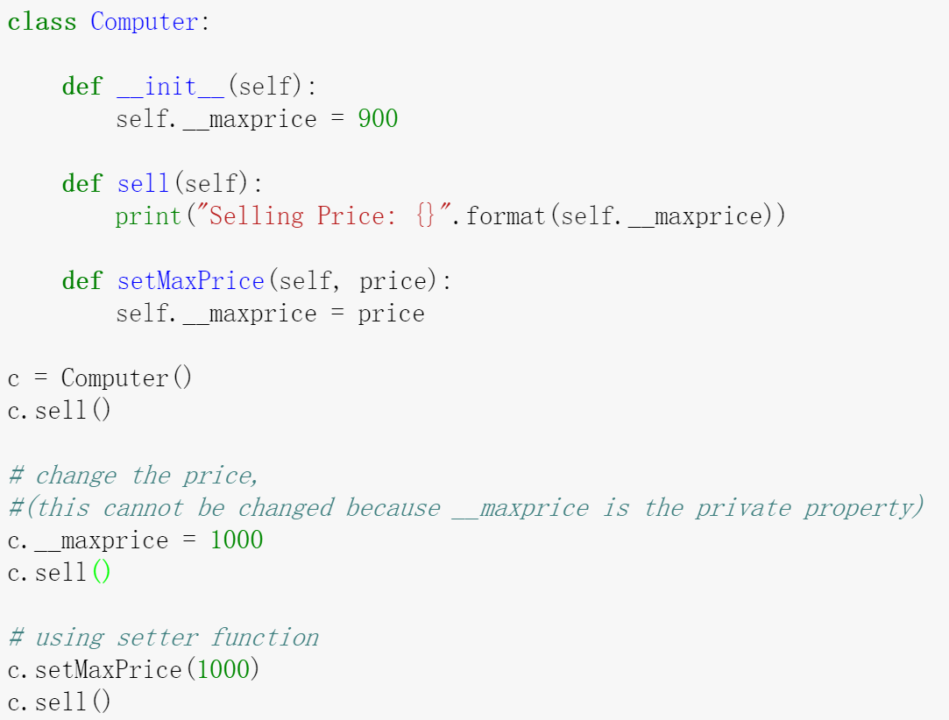
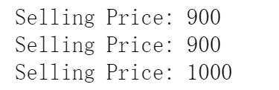
Encapsulation
Using OOP in Python, we can restrict
access to methods and variables.
This prevent data from direct
modification which is called
encapsulation. In Python, we denote
private attribute using underscore as
prefix i.e single “ _ “ or double “ __“.

Slide 79
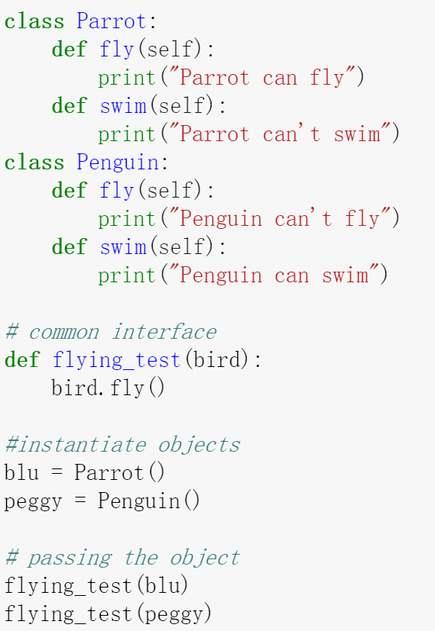
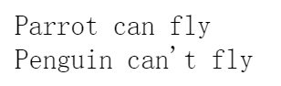
Polymorphism
Polymorphism is an ability (in OOP) to use common interface for multiple form.
Suppose, we need to color a shape, there are multiple shape option (rectangle, square, circle).
However we could use same method to color any shape. This concept is called Polymorphism.

Slide 80

4. Importing and Modules

Slide 81
Import and Modules
Programs will often use classes & functions defined in another file
A Python module is a single file with the same name (plus the .py
extension)
Modules can contain many classes and functions
Access using import
Where does Python look for module files?
The list of directories where Python looks: sys.path
When Python starts up, this variable is initialized from the PYTHONPATH environment variable
To add a directory of your own to this list, append it to this list.
sys.path.append(‘/my/new/path’)

Slide 82
Import and Modules
import somefile
Everything in somefile.py can be referred to by: somefile.className.method(“abc”) somefile.myFunction(34)
from somefile import *
Everything in somefile.py can be referred to by: className.method(“abc”) myFunction(34)
Careful! This can overwrite the definition of an existing function or variable!

Slide 83
Import and Modules
from somefile import className
Only the item className in somefile.py gets imported.
Refer to it without a module prefix.
Caveat! This can overwrite an existing definition.
className.method(“abc”)
This was imported
myFunction(34)
Not this one

Slide 84
Commonly used modules for scientific computing
Numpy
Matrix calculation
Scipy
Numeric calculation
Scikit-learn
Machine learning
Matplotlib
Plotting
Seaborn
Plotting

Slide 85

Section 2: Scientific computing
5. Numpy
import numpy as np

Slide 86
Why numpy?
Used in almost all numerical computations in Python • Used for high-performance vector and matrix computations • Provides fast precompiled functions for numerical routines • Written in C and Fortran • Vectorized computations

Slide 87
Arrays
>>> import numpy as np
>>> v = np.array ([1 ,2 ,3 ,4])
# the argument to the array function is a Python list
>>> M = np.array ([[1 , 2], [3, 4]])
# the argument to the array function is a nested Python list
>>> type (v), type (M) ( numpy . ndarray , numpy . ndarray )

Slide 88
Arrays
>>> v.shape , M. shape ((4 ,) , (2, 2))
>>> M. size 4
>>> M. dtype dtype (’int32’)
# Explicitly define the type of the array
>>> M = np.array ([[1 , 2], [3, 4]] , dtype=complex )

Slide 89
Arrays - Using array-generating functions
>>> np.arange (0, 10, 1) # arguments : start , stop , step array ([0, 1, 2, 3, 4, 5, 6, 7, 8, 9])
>>> np.linspace (0,10,11)
# arguments : start , end and number of points (start and end points are included ) array ([ 0., 1., 2., 3., 4., 5., 6., 7., 8., 9., 10.])

Slide 90
Mgrid
>>> x,y = np.mgrid [0:3 ,0:2]
>>> x array ([[0 , 0], [1, 1], [2, 2]])
>>> y array ([[0 , 1], [0, 1], [0, 1]])

Slide 91
Diagonal and zero matrix
>>> np.diag ([1 ,2 ,3]) array ([[1 , 0, 0], [0, 2, 0], [0, 0, 3]])
>>> np.zeros ((3 ,3) ) array ([[ 0., 0., 0.] , [ 0., 0., 0.] , [ 0., 0., 0.]])

Slide 92
Array access
>>> M = np.random . rand (3 ,3) # not a Numpy function
>>> M array ([ [ 0.37389376 , 0.64335721 , 0.12435669] , [ 0.01444674 , 0.13963834 , 0.36263224] , [ 0.00661902 , 0.14865659 , 0.75066302]])
>>> M[1 ,1] 0.13963834214755588

Slide 93
Array access
# Access the first row >>> M [0] array ([0.01444674 , 0.13963834 , 0.36263224])
# The first row can be also be accessed using this notation >>> M[0 ,:] array ([ 0.01444674 , 0.13963834 , 0.36263224])
# Access the first column >>> M[: ,0] array ([0.64335721 , 0.13963834 , 0.14865659])
Note: The first element in array is indexed by 0. Important!!!

Slide 94
Array access
# You can also assign values to an entire row or column
>>> M[1 ,:] = 0
>>> M
array ([
[ 0.37389376 , 0.64335721 , 0.12435669] ,
[ 0. , 0. , 0. ],
[ 0.00661902 , 0.14865659 , 0.75066302]])

Slide 95
Array slicing
# Extract slices of an array
>>> M[1:3]
array([
[ 0. , 0. , 0. ],
[ 0.00661902 , 0.14865659 , 0.75066302]])
>>> M[1:3 ,1:2]
array ([
[ 0. ],
[ 0.14865659]])
Note: M[a:b] will return the elements indexed from a to b-1.

Slide 96
Array slicing — Negative indexing
# Negative indices start counting from the end of the array
>>> M[-2]
array ([0., 0., 0.])
>>> M[-1]
array([0.00661902, 0.14865659, 0.75066302])
Note: -1 is the index of the right-end element

Slide 97
Array access — strided access
# Strided access, [start_index: end_index(not_including): stride]
>>> M [::2 ,::2]
array ([[ 0.37389376 , 0.12435669] ,
[ 0.00661902 , 0.75066302]])
>>> M [:-1:2 ,:-1:2]
array ([[ 0.37389376]])

Slide 98
Array operations — Scalar
These operation are applied to all the elements in the array
>>> M*2 array ([ [ 0.74778752 , 1.28671443 , 0.24871338] , [ 0. , 0. , 0. ], [ 0.01323804 , 0.29731317 , 1.50132603]])
>>> M + 2 array ([ [ 2.37389376 , 2.64335721 , 2.12435669] , [ 2. , 2. , 2. ], [ 2.00661902 , 2.14865659 , 2.75066302]])

Slide 99
Array operations — matrix multiplication
>>> M * M # Element - wise multiplication
array ([
[1.397965e-01, 4.139085e-01, 1.546458e-02] ,
[0.000000e+00, 0.000000e+00, 0.00000e+00] ,
[4.381141e-05, 2.209878e-02, 5.634949e-01]])
>>> np.dot(M,M) # Matrix multiplication, equals to np.matmul(M,M)
array ([
[0.14061966 , 0.25903369 , 0.13984616] ,
[0. , 0. , 0. ],
[0.00744346 , 0.1158494 , 0.56431808]])

Slide 100
Iterating over Array Elements
• In general, avoid iteration over elements • Iterating is slow compared to a vector operation • If you must, use the for loop • In order to enable vectorization, ensure that user-written functions can work with vector inputs. • Use the vectorize function • Use the any or all function with array

Slide 101
Vectorize
>>> def Theta (x):
"""
Scalar implemenation of theHeaviside step function .
"""
if x >= 0:
return 1
else :
return 0
>>> Theta (1.0)
1
>>> Theta ( -1.0)
0

Slide 102
Vectorize
Without vectorize we would not be able to pass v to the function
>>> v = np.arange(1,5)
array ([1 , 2, 3, 4])
>>> Tvec = np.vectorize ( Theta )
>>> Tvec (v)
array ([1 , 1, 1, 1])
>>> Tvec (1.0)
array (1)

Slide 103
Arrays in conditions
Use the any or all functions associated with arrays
>>> v array ([1 , 2, 3, 4])
>>> (v > 3). any () True # True if there is one element meets the condition
>>> (v > 3). all () False # True if there all of the elements meet the condition

Slide 104

6. Scipy

Slide 105
Scipy
SciPy framework built on top of the NumPy framework
SciPy imports all the functions from the NumPy namespace
Scipy can realize large number of scientific algorithms
Integration
Optimization
Linear Algebra
Sparse Eigenvalue Problems
Statistics
File I/O
Fourier Transforms
... and many more

Slide 106
Subpackages
Using any of these subpackages requires an explicit import
Linear Algebra
Optimization
Integration

Slide 107
Linear Algebra
To solve an equation of the form Ax = b
>>> from scipy import * >>> from scipy import linalg >>> A = np.array([[1 ,2 ,3] , [4 ,5 ,6] , [7 ,8 ,9]]) >>> b = np.array([1 ,2 ,3])
>>> x = linalg.solve(A, b) array ([ -0.33333333 , 0.66666667 , 0. ])
>>> linalg.norm(dot(A, x) - b) #validate 1.1102230246251565 e -16

Slide 108
Linear Algebra - Inverse
>>> A = np.random.rand(3 ,3) >>> A array ([ [ 0.24514116 , 0.52587023 , 0.18396222] , [ 0.90742329 , 0.16622943 , 0.13673048] , [ 0.09218907 , 0.51841822 , 0.5672206 ]])
>>> linalg.inv (A) array ([ [ -0.13406351 , 1.16228558 , -0.23669318] , [ 2.87602299 , -0.69932327 , -0.76418374] , [ -2.60678741 , 0.45025145 , 2.49988679]])

Slide 109
Linear Algebra – Eigenvalues and Eigenvector
>>> evals, evecs = linalg.eig(A) >>> evals array ([-0.46320383+0.j, 1.09877378+0. j, 0.34302124+0. j])
>>> evecs array ([ [ -0.49634545 , 0.49550686 , -0.20682981] , [ 0.79252573 , 0.57731361 , -0.35713951] , [ -0.35432211 , 0.64898532 , 0.91086377]])

Slide 110
Optimization
Compute the minima of a single variable function
>>> from scipy import optimize >>> def f(x): return 4*x**3 + (x -2) **2 + x**4

Slide 111
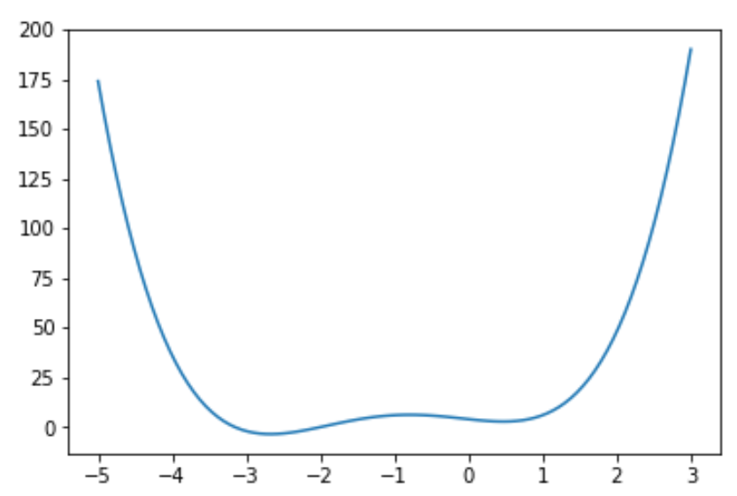
Optimization

Slide 112
Optimization
>>> x_min = optimize.fmin_bfgs(f, -2)
Optimization terminated successfully . Current function value : -3.506641 Iterations : 6 Function evaluations : 30 Gradient evaluations : 10
>>> x_min
array ([ -2.67298167])

Slide 113
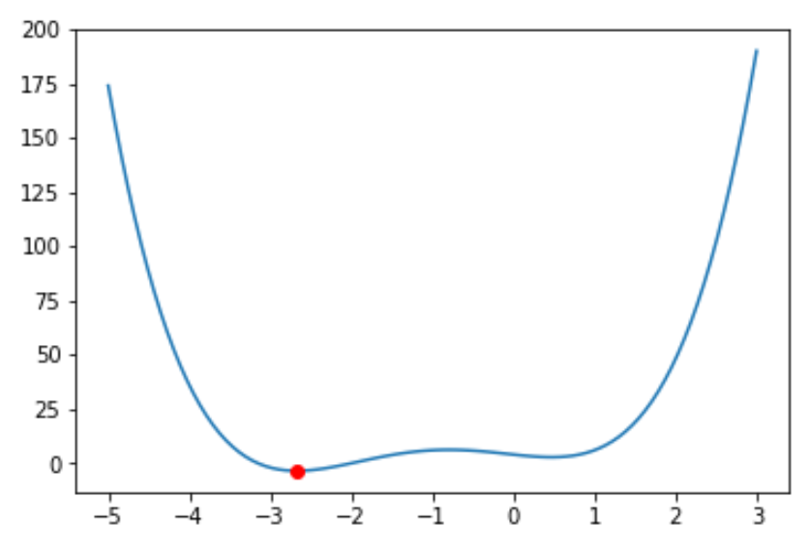
Optimization
Minimum point

Slide 114
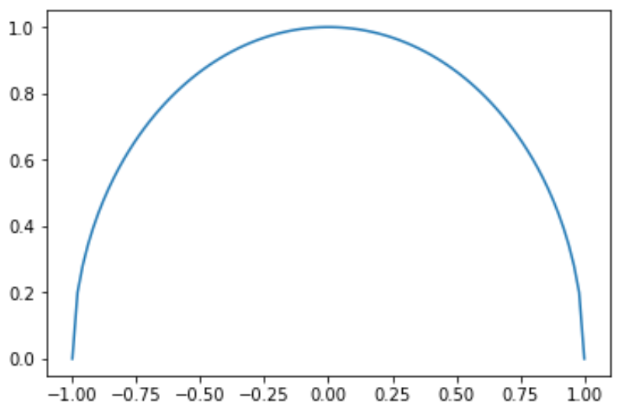
Integration
>>> def half_circle(x):
return (1-x**2)**0.5

Slide 115
Integration
Calculate the area of the half circle
>>> from scipy import integrate
>>> pi_half, err = integrate.quad(half_circle, -1, 1)
>>> pi_half*2
3.141592653589797
>>> err
1.0002356720661965e-09

Slide 116
Statistics
>>> from scipy import stats
>>> X = stats.norm(loc=1.0, scale=2.0)
#loc is the mean value, scale is the standard deviation
>>> x = X.rvs(size=10000) # get 10000 samples from random variable
>>> np.mean(x)
1.0235502154314298
>>> np.std(x)
1.999466195598207

Slide 117
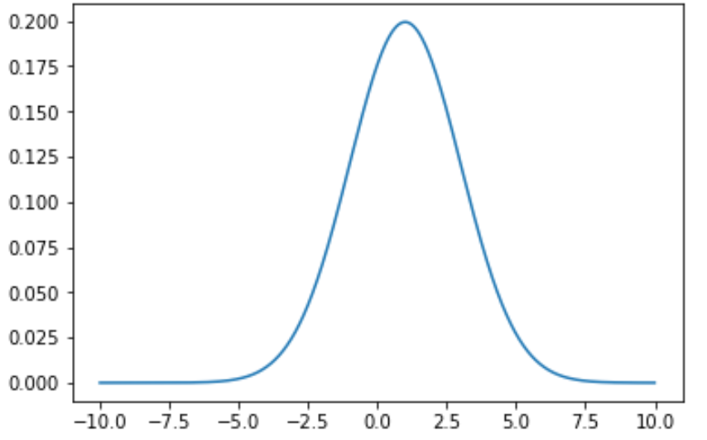
Statistics
>>> import matplotlib.pyplot as plt # will be introduced later
>>> t = np.arange(-10,10,0.01)
>>> plt.plot(t, X.pdf(t))

Slide 118

7. Matplotlib

Slide 119
Matplotlib
Used for generating 2D and 3D scientific plots
Support for LaTeX
Fine-grained control over every aspect
Many output file formats including PNG, PDF, SVG, EPS
Matplotlib is the entire library
Pyplot - a module within Matplotlib that provides access
to the underlying plotting library
Please look up help documentation for further illustrations
of parameter settings

Slide 120
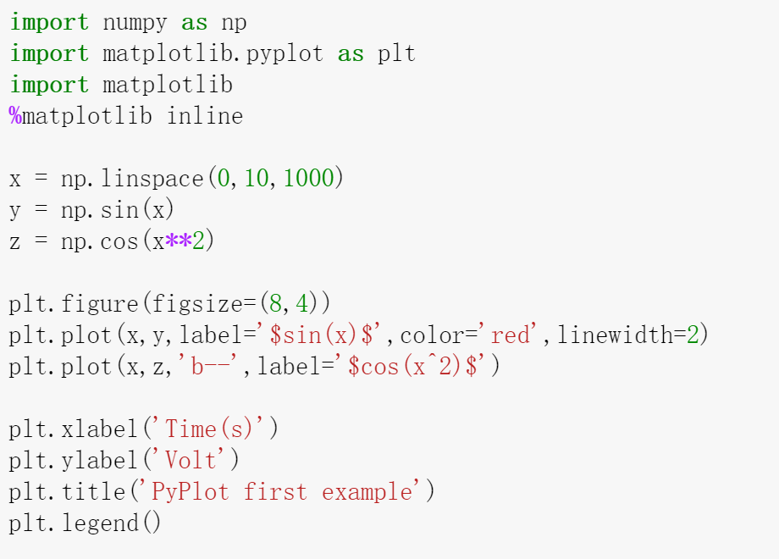
pyplot — first example
Notes:
Label, color, linewidth, legend,

Slide 121
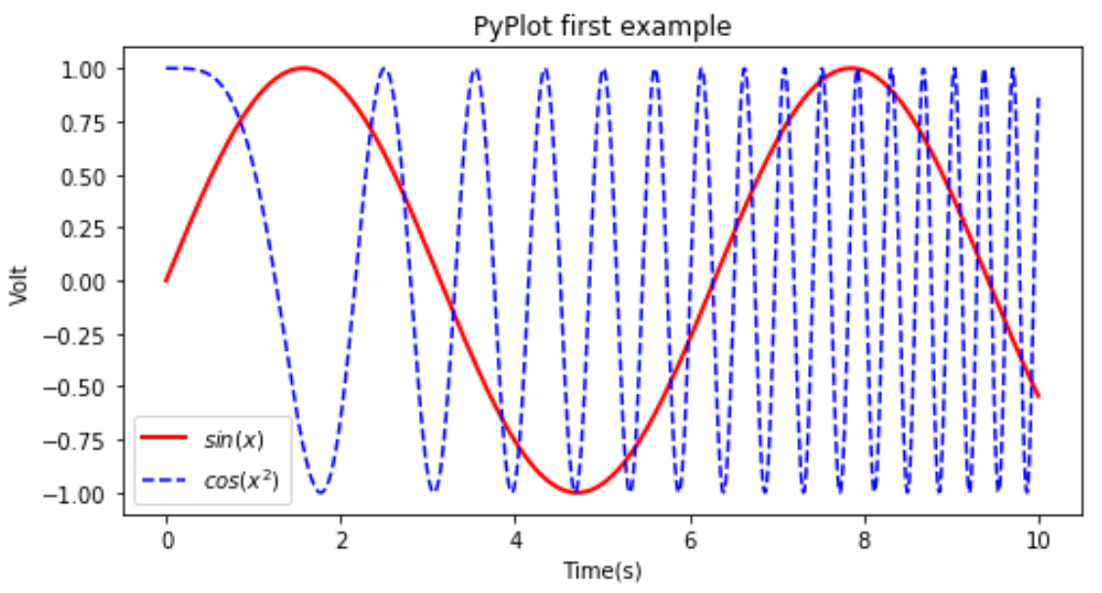
pyplot — first example

Slide 122
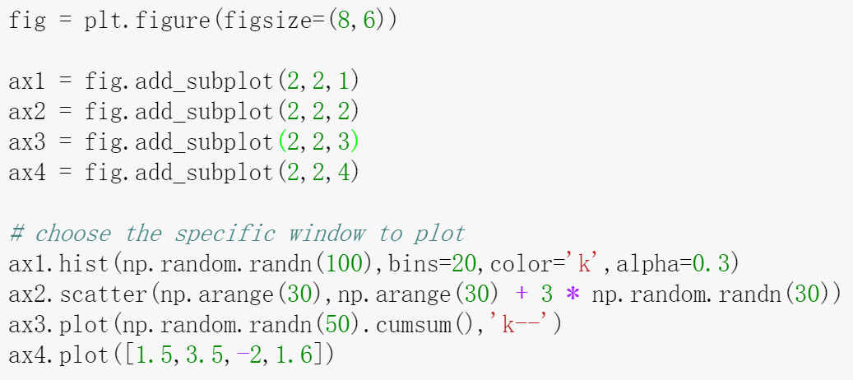
subplots

Slide 123
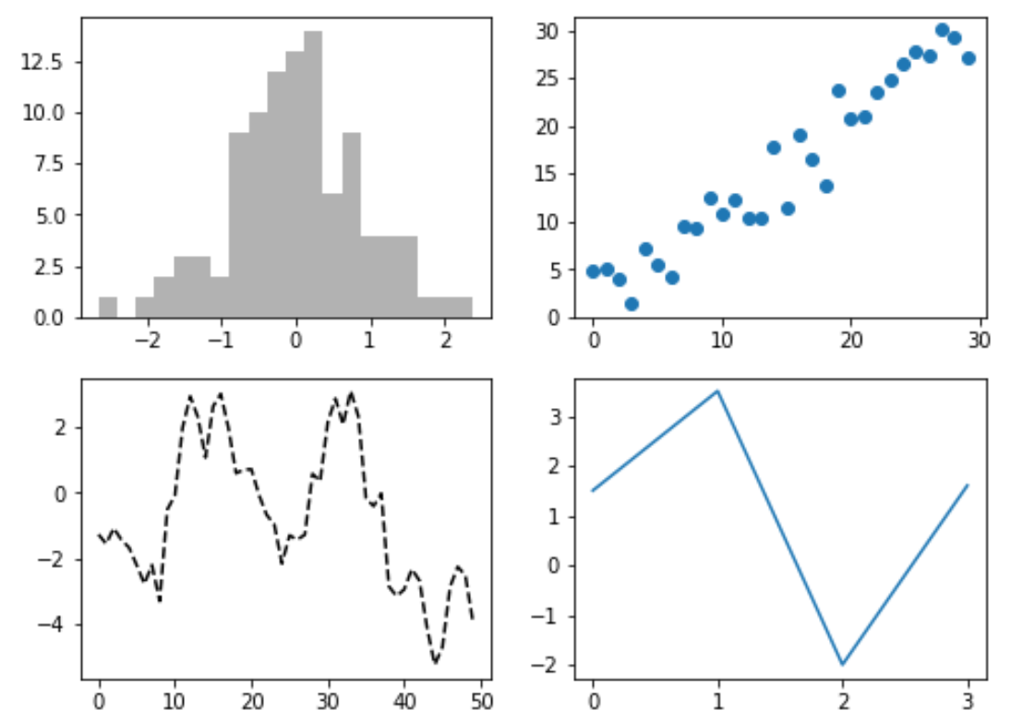
subplots

Slide 124
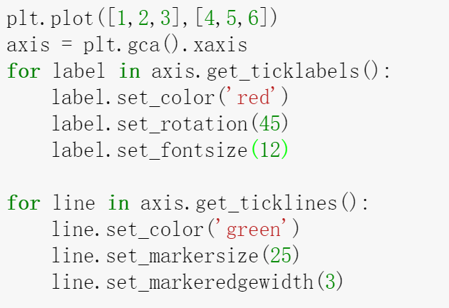
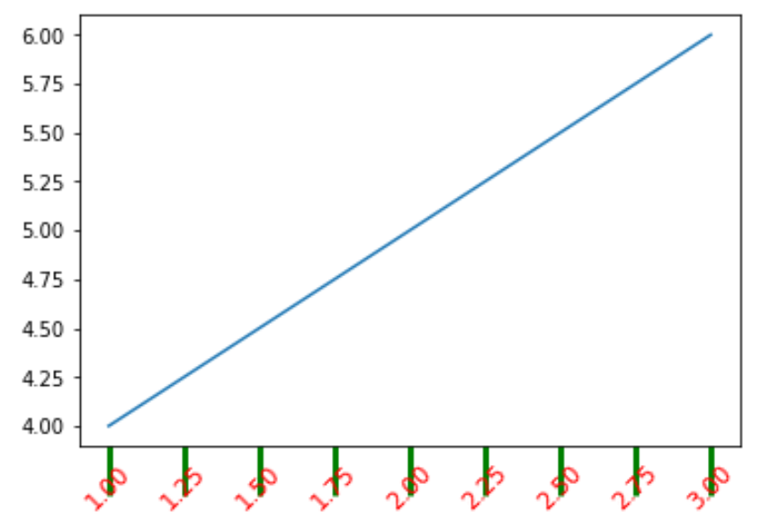
Set ticklabels of axis

Slide 125
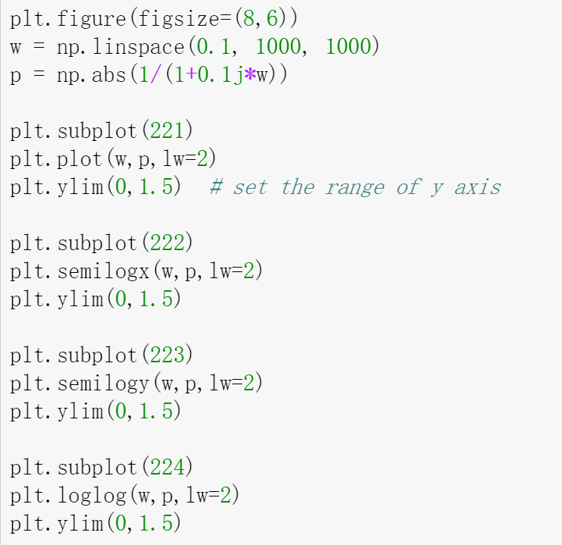
Logarithmic plot

Slide 126
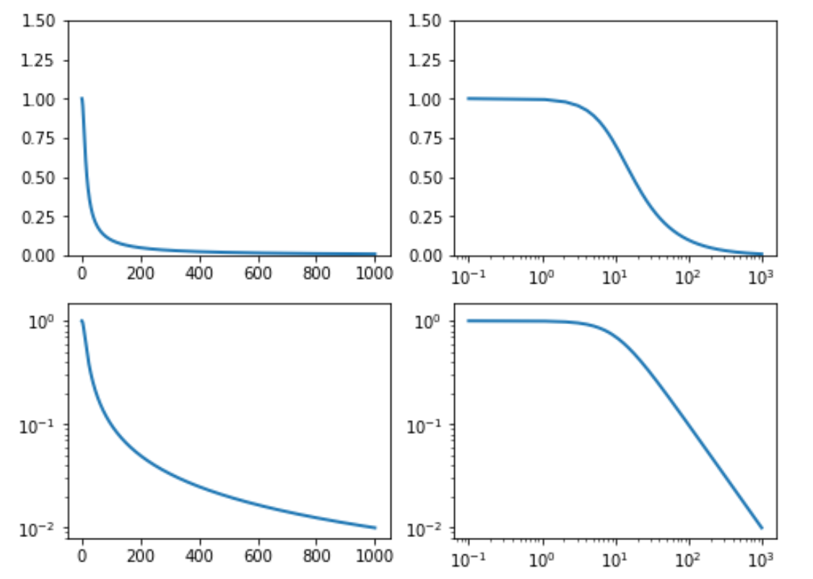
Logarithmic plot

Slide 127
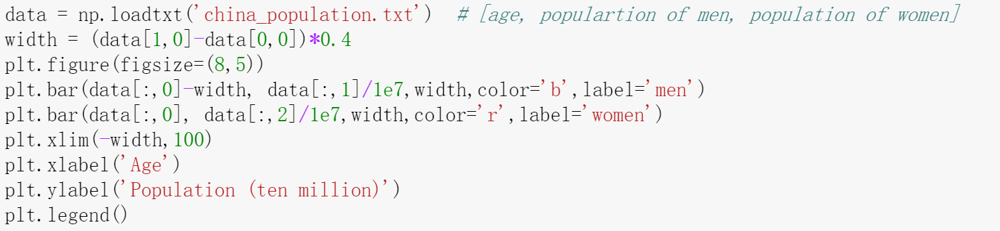
Histogram

Slide 128
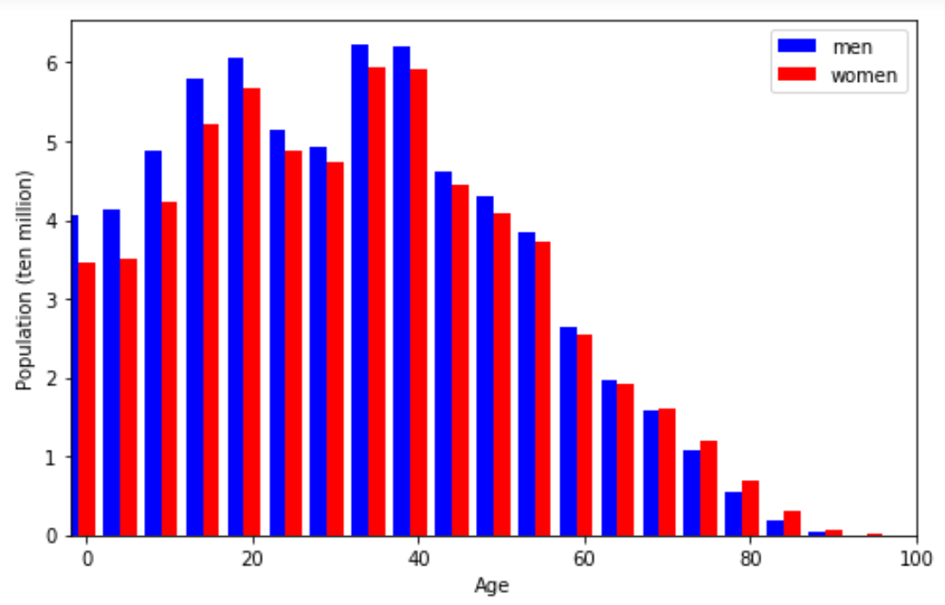
Histogram

Slide 129
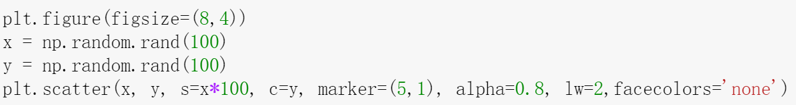
Scatter plot

Slide 130
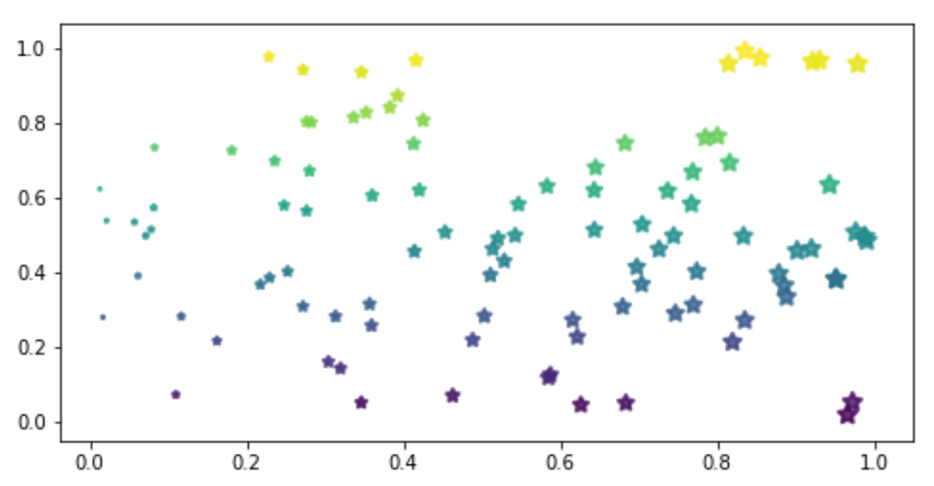
Scatter plot

Slide 131
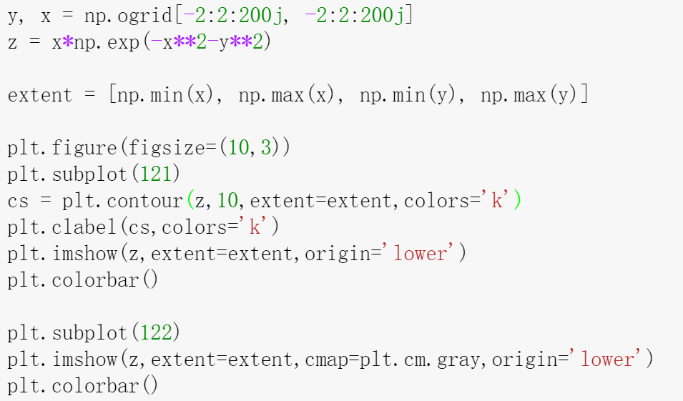
Image visualization and contour

Slide 132
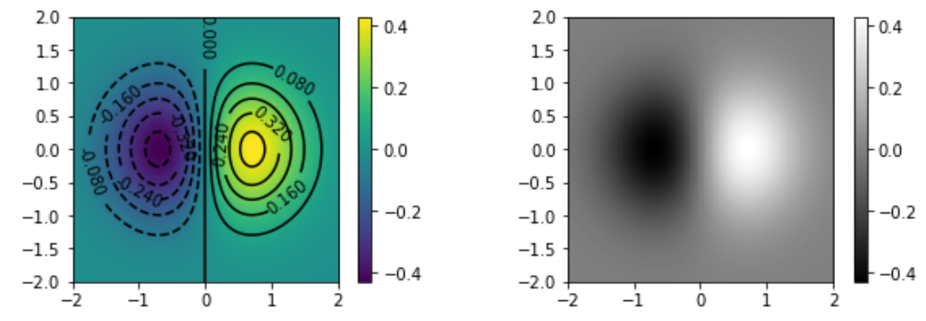
Image visualization and contour

Slide 133
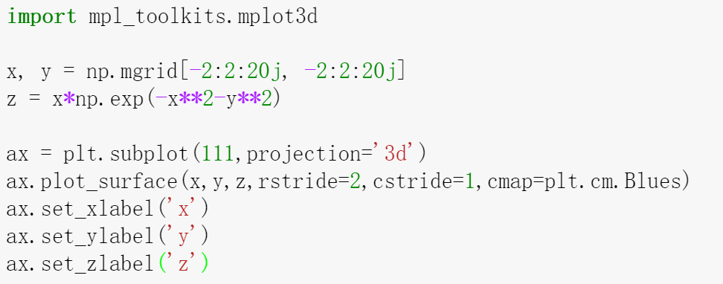
3D plotting

Slide 134
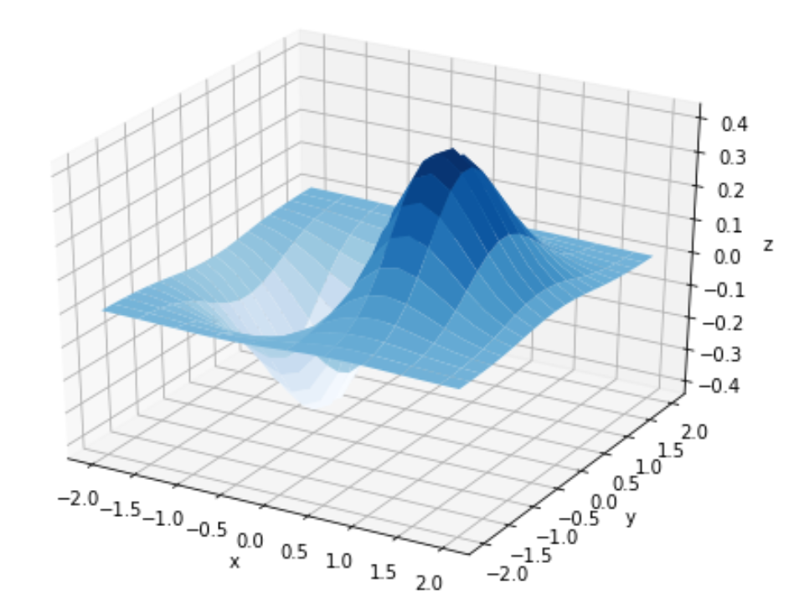
3D plotting

